Slide 1

Counterfeit Integrated Circuit (IC) Detection Using Image Processing

Slide 2


Declaration
I, Sruti Bhattacharjee, hereby, declare that this PowerPoint presentation is an authentic work being carried out by me under the guidance of Dr. Rajat Shubhra Chakraborty of Computer Science and Engineering Department, Indian Institute of Techno and is approved as final year project by Department of Information Technology of MCKV Institute of Engineering. I’m submitting this to Maulana Abul Kalam Azad University of Technology for as a work to get bachelor degree in Information Technology.
Sruti Bhattacharjee
IT/14/20
Roll No: 11600214049

Slide 3
OBJECTIVEs
Detection and classification of Counterfeit Integrated Circuit
Feature detection algorithm development
Explore image analysis techniques and their limitations

Slide 4
contents
Introduction
Background
Tests for Counterfeit Detection
Work Done
Pin Feature Detection and Extraction
Results
Challenges Faced
Proposed Hypotheses
What is CNN?
Why use CNN?
How to use CNN?
Future Work
Conclusion
References

Slide 5
INTRODUCTION
Counterfeit products are fake and are often produced with the intent to take advantage of the superior value of the imitated product
NEC products
Counterfeit business and Operational Network Raider
Unique components of an IC not made by company intentionally

Slide 6
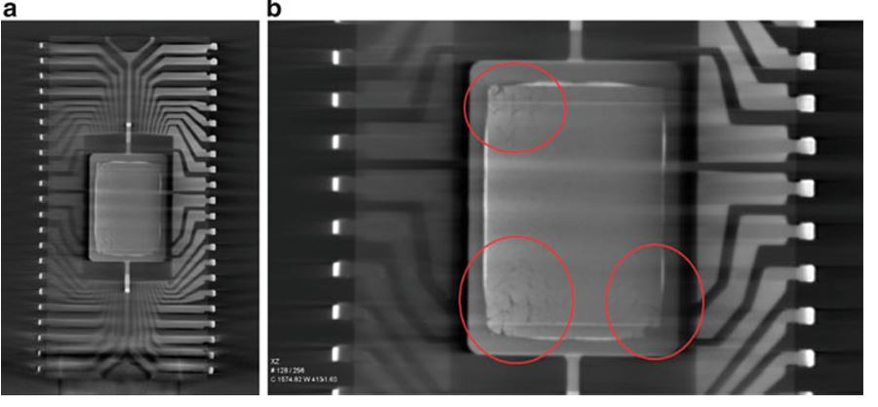
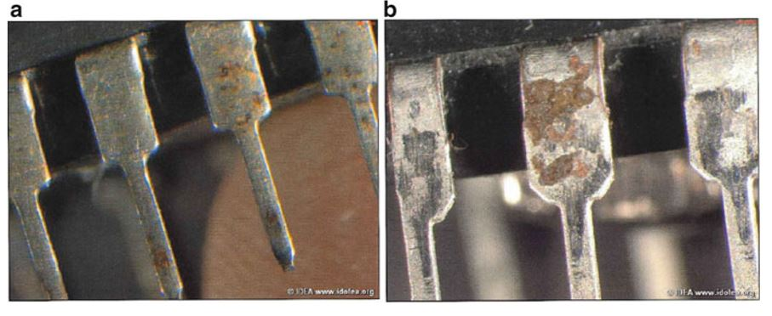
BACKGROUND
Integrated Circuits form the core of any electronic product be it a highly sophisticated lab instrument or the power convertor in our phone charger
There are different types of ICs and hence a wide scope for illegal counterfeits to contaminate the market
It is the defects in the fake ones which help us to distinguish the original ICs from the counterfeits

Slide 7
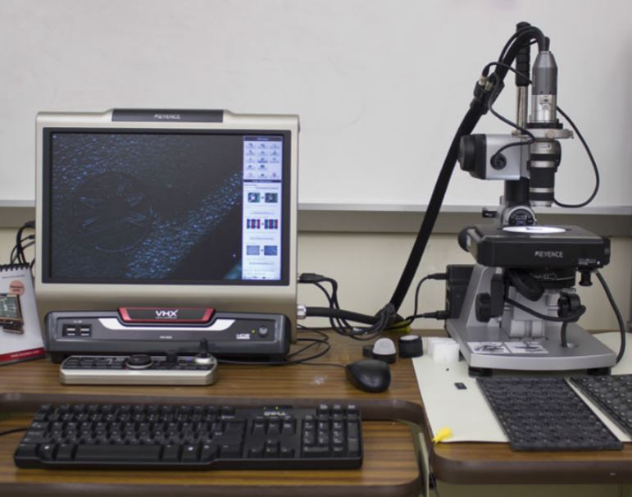
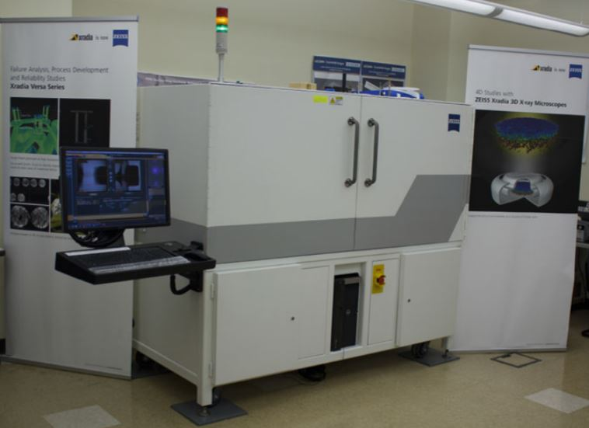
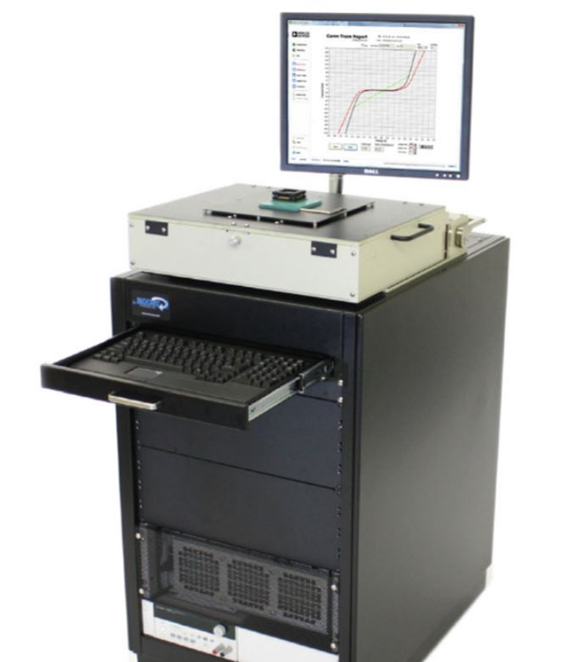
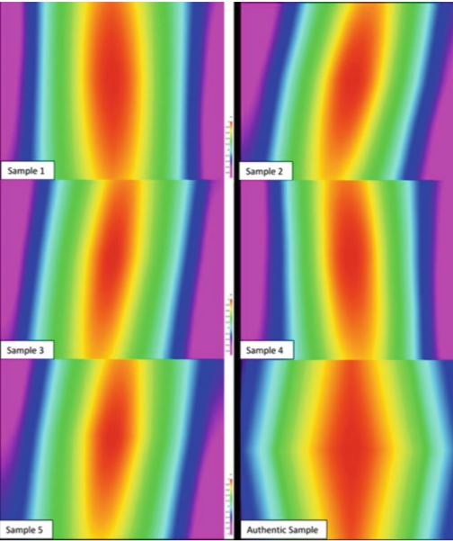
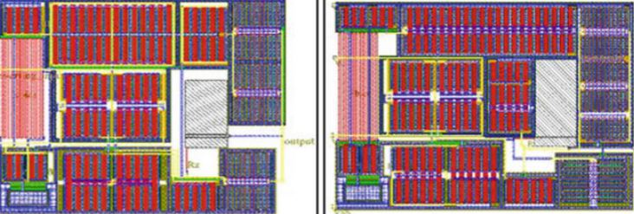
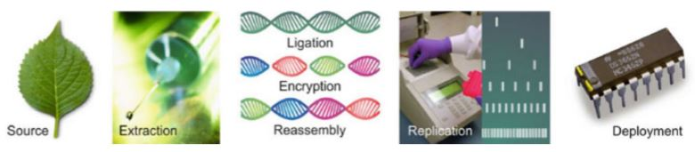
TESTS FOR COUNTERFEIT DETECTION
Detailed EVI
Zeiss Xradia 510 Versa
Curve Tracing
Physical Tests
Watermarking
DNA marking
Basic Image processing approaches

Slide 8
WORK DONE
Primarily we tried basic image processing techniques to detect and extract pins of an IC from it’s image
But what we felt it is time consuming and complex to develop mathematically
So we tried mask based segmentation and it needed us to develop mask for each ICs differently which is not intended
That is why we realized a need for much simpler and computationally efficient deep learning based method for IC classification

Slide 9
Pin feature DETECTION AND EXTRACTION
IC Image is acquired in various orientation using an Optical Microscope
Feature extraction is done by two methods:
  Point Feature Matching: This method matches the most significant feature points in the pin image and tries to match it with the significant points in the IC image
  Mask Based Segmentation: A mask is made by a predefined processing pipeline which is then used to segment the IC image using the Image Segmenter App in MATLAB
Both of the methods are based on basic image processing techniques

Slide 10
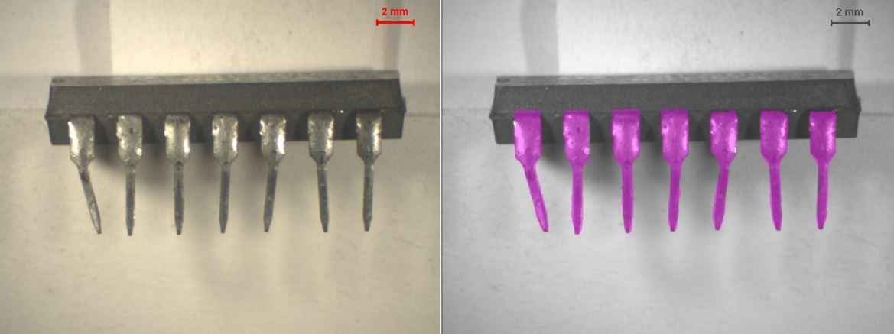
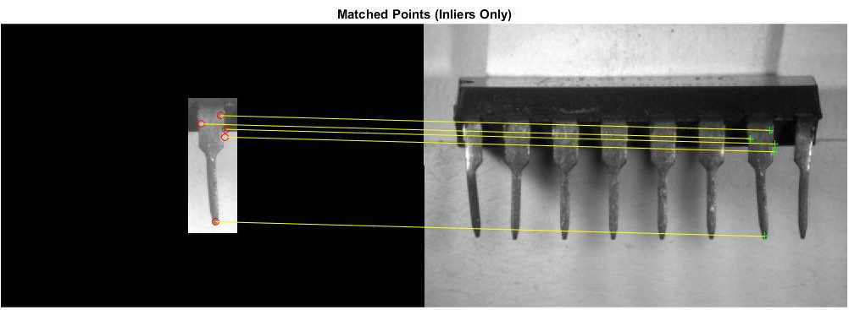
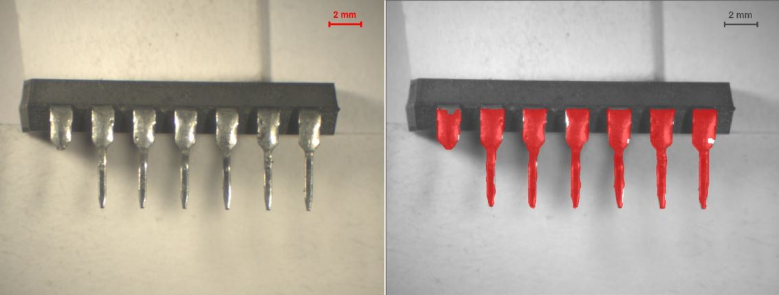
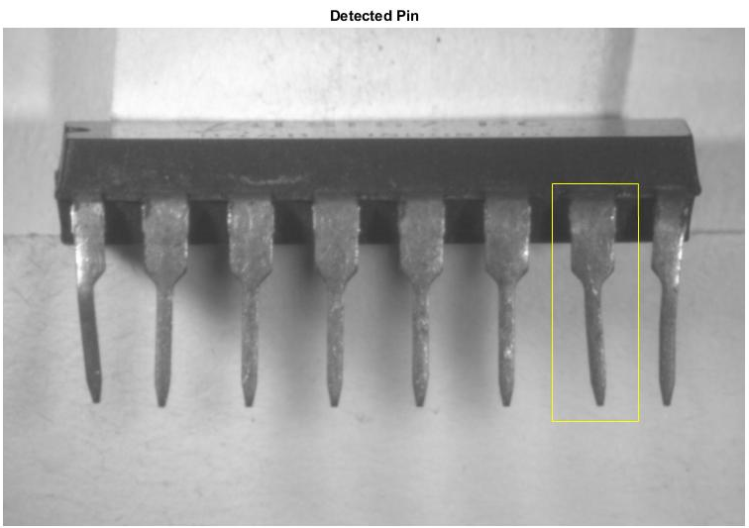
Results
Masked based segmentation
Point feature matching

Slide 11
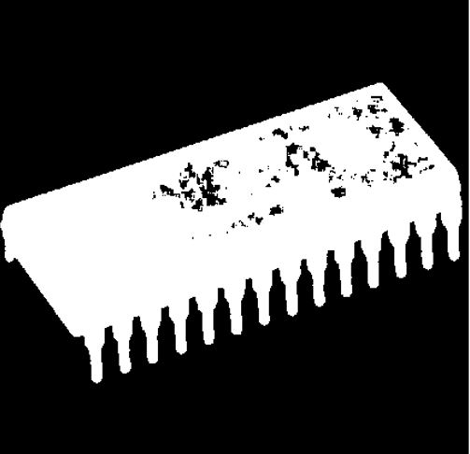
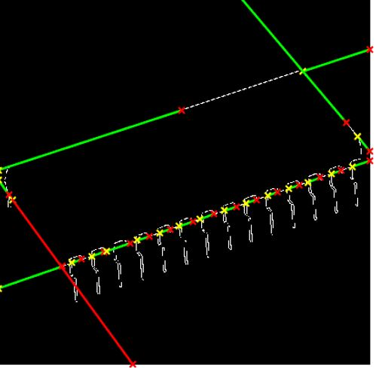
Challenges faced
Not computationally efficient and rigorous in nature
Masks are very difficult to make
Point feature does not give satisfactory results for slight variations
We also tried texture based segmentation, Gabor filter, Hough transform and UV ray techniques but with unsatisfactory results
UNSUCCESSFUL RESULT:

Slide 12
PREDICTED HYPOTHESES
Deep learning to detect counterfeit ICs
Using biometrics to detect age of a pin

Slide 13
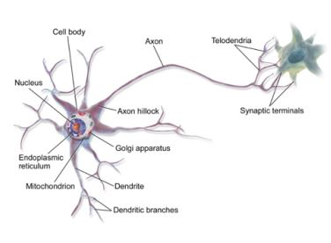
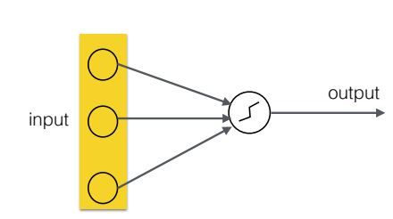
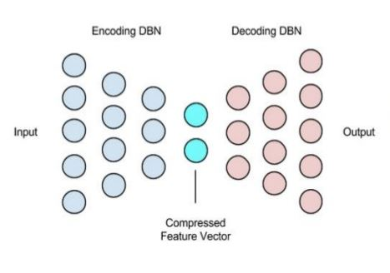
What is Cnn ?
A Neural Network is analogous to functioning neurons in human brain and it can be trained to carry out desired tasks
The deep learning auto-encoders are composed of two symmetrical deep belief networks
The encoding network learns to compress the input vector and the decoding network can be used to reconstruct the data
A robust machine learning technique

Slide 14
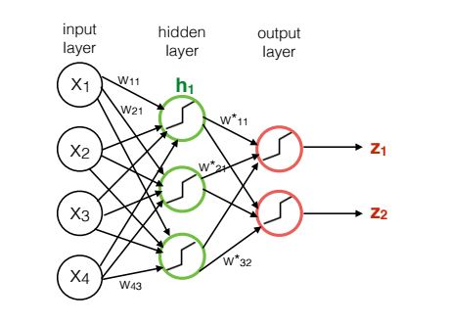
WHY USE CNN?
It is data driven approach. So higher the data, the more accurate results we get
It is very robust in nature
High accuracy and efficient
Very popularly used as an object classification tool
Computationally efficient, although for training purposes, computational cost is high and we need a good GPU

Slide 15
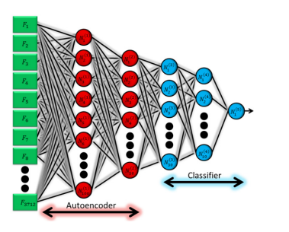
How to use cnn?
The deep neural network consists of one input layer followed by a stacked auto encoder and a multilayer neural network classifier
The overall architecture results in four hidden layers and one output layer
The classifier part of the network and the auto encoder layers are trained differently to avoid the problems associated with training all the layers of a deep network using only backpropagation
The stacked auto encoder is trained using a greedy layer-wise approach
The network is trained with counterfeit IC images

Slide 16
Future work
CNN database make to train machine for IC pins using Tensorflow
Collect minimum 600 microscopic images for each type of ICs
CNN algorithm development if needed

Slide 17
conclusion
We explored basic image processing techniques for like Point Feature Matching and Mask Based Segmentation for detection and extraction of pins which we then through analysis tried to determine if the IC is counterfeit or not
The method was neither computationally efficient nor robust in approach
We moved on to Convolutional Neural Networks and deep learning techniques because of their accuracy and robustness
Our future work will thus focus on training of such neural net and build an efficient classifier

Slide 18
References
Use of the Hough Transformation To Detect Lines and Curves in Pictures by Richard O. Duda and Peter E. Hart,pages 2
Using Hidden Markov Models for Feature Extraction in Paper Currency Recognition by H. Hassanpour and E. Hallajian, pages 4
S. Arya and D. M. Mount. Approximate nearest neighbor searching. Proc. 4th Annual ACM-SIAM Symposium on Discrete Algorithms, pages 271-280, 1993
I. Jermyn and H. Ishikawa. Globally Optimal Regions and Boundaries as Minimum Ratio Weight Cycles. IEEE Transactions on Pattern Analysis and Machine Intelligence, vol 23, pages 1075-1088, October 2001
Mask Defenition for WBC Segmentation by Hossein SAHOOLIZADEH pages 3-5, 2009
Counterfeit Integrated Circuits: A Rising Threat in the Global Semiconductor Supply Chain by U Guin, page 2-5, IEEE 2014
A Character-Level Convolutional Neural Network with Embeddings For Detecting Malicious URLs, File Paths and Registry Keys by Joshua Saxe and Konstantin Berlin, page 12-18, 27 Feb 2017
A Survey of Modern Questions and Challenges in Feature Extraction by GOOGLE Research JMLR: Workshop and Conference Proceedings 44, page 5-10, NIPS 2015
ImageNet Classification with Deep Convolutional Neural Networks by University of Tokyo, page 2-4 ImageNet LSVRC-2010 contest

Slide 19
Thank you for your time!
Any questions?
Any criticisms?

